Slide 1
FUDGEMART & FUDGEFLIX SALES ANALYSIS
Presented By -
Nishit Nakrani
Krupal Vora
Shraddha Sawant
Ashutosh Jha
Nikhil Jhurani
Piyush Gupta
IST 722 DATA WAREHOUSE
FALL 2020
PROF. HUMAYUN H KHAN

Slide 2


FUDGEMART AND FUDGEFLIX

Slide 3
FudgeCorp. Inc. has two companies: FudgeFlix and FudgeMart
FudgeMart is a mega-store retailer such as Amazon
FudgeFlix is an online dvd or video on demand retailer such as amazon prime

Slide 4
BUSINESS GOALS
Increase the Revenue
Optimize Sales regionally
Identify the Cash Cows and Dogs of the Corporation
Boost Customer Lifetime Value
Identify the opportunities for Cross-selling

Slide 5
FUNCTIONAL REQUIREMENTS
What are frequently sold and least sold products?
What are the most revenue-generating and least revenue-generating products?
Who are the top and loyal customers?
Regional Sales Analysis – How are states performing in terms of sales?
What and how is the demands for the products in the market?
Who and How do we cross-sell?
When is a good time to market and sell the products?
How is each subsidiary performing comparatively?

Slide 6
KNOW THE DATA: FUDGEMART
customer_id
customer_email
customer_firstname
customer_lastname
customer_city
customer_state
customer_zip
CUSTOMER
CUSTOMER CREDITCARD
PRODUCT
PRODUCT REVIEW
product_id
product_name
product_department
prouduct_is_active
product_retail_price
product_wholesale_price
VENDOR
EMPLOYEE
EMPLOYEE TIMESHEET
order_id
order_date
ORDER
ORDER DETAILS
order_qty
DATA WE HAVE
DATA WE NEED

Slide 7
KNOW THE DATA : FUDGEFLIX
ACCOUNT
account_id
account_email
account_firstname
account_lastname
zipcode_city
zipcode
ACCOUNT TITLE
PLAN
plan_current
plan_price
GENRE
zip_city
Zip_state
DIRECTOR
CAST
ZIP CODES
ACCOUNT BILLING
ab_id
ab_account_id
ab_date
ab_billed_amount
DATA WE HAVE
DATA WE NEED

Slide 8
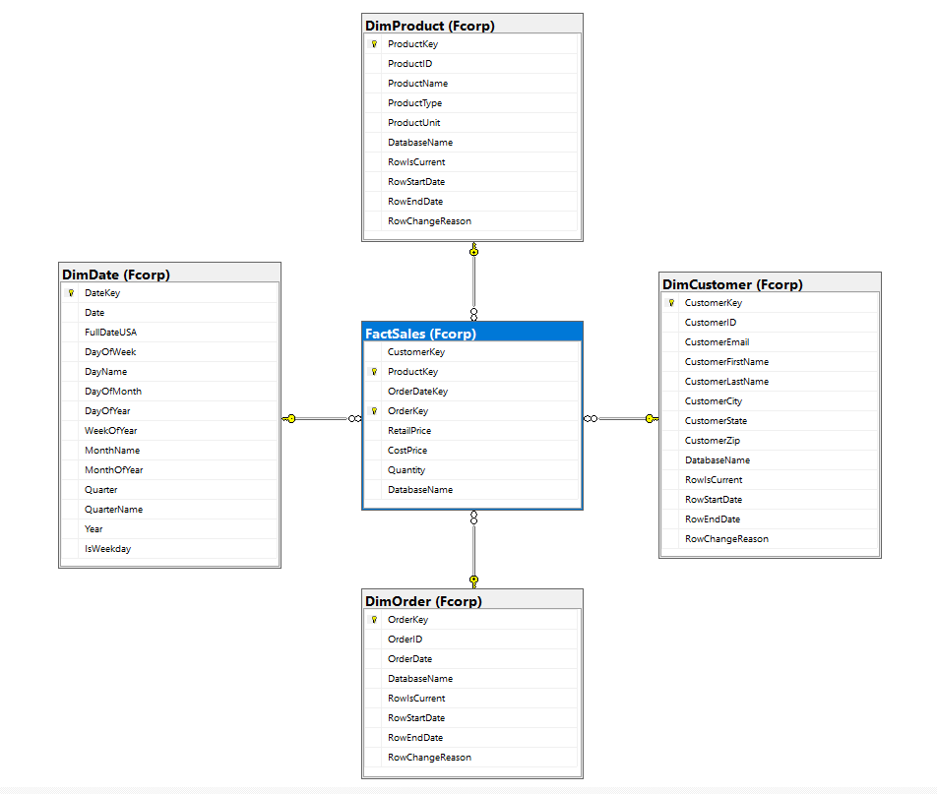
STAR SCHEMA

Slide 9
ETL PROCESS
SOURCE
STAGING
DATAWAREHOUSE
Stg_FMCustomers
Stg_FMOrders
Stg_FMProducts
Stg_FMFactSales
DimCustomer
FUDGEMART
DimProduct
Stg_FFAccounts
Stg_FFOrders
Stg_FFPlans
Stg_FFFactSales
DimOrder
FUDGEFLIX
FactSales
EXTERNAL
SOURCE
DimDate
Fcorp_StgDate

Slide 10
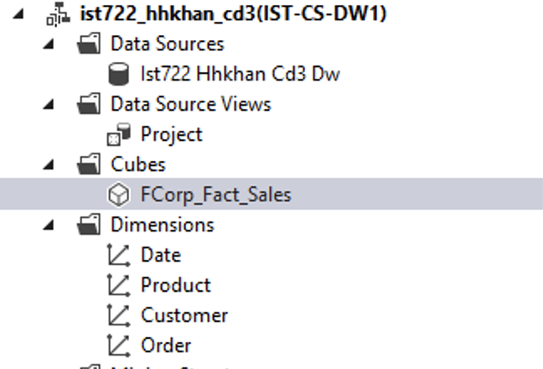
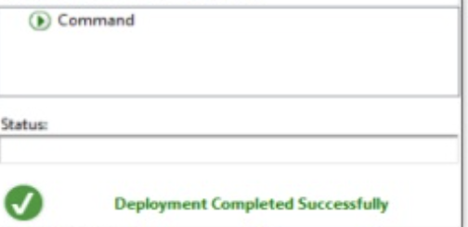
DEPLOYING THE CUBE

Slide 11

SALES:BI VISUALS
A picture is worth a thousand words.

Slide 12
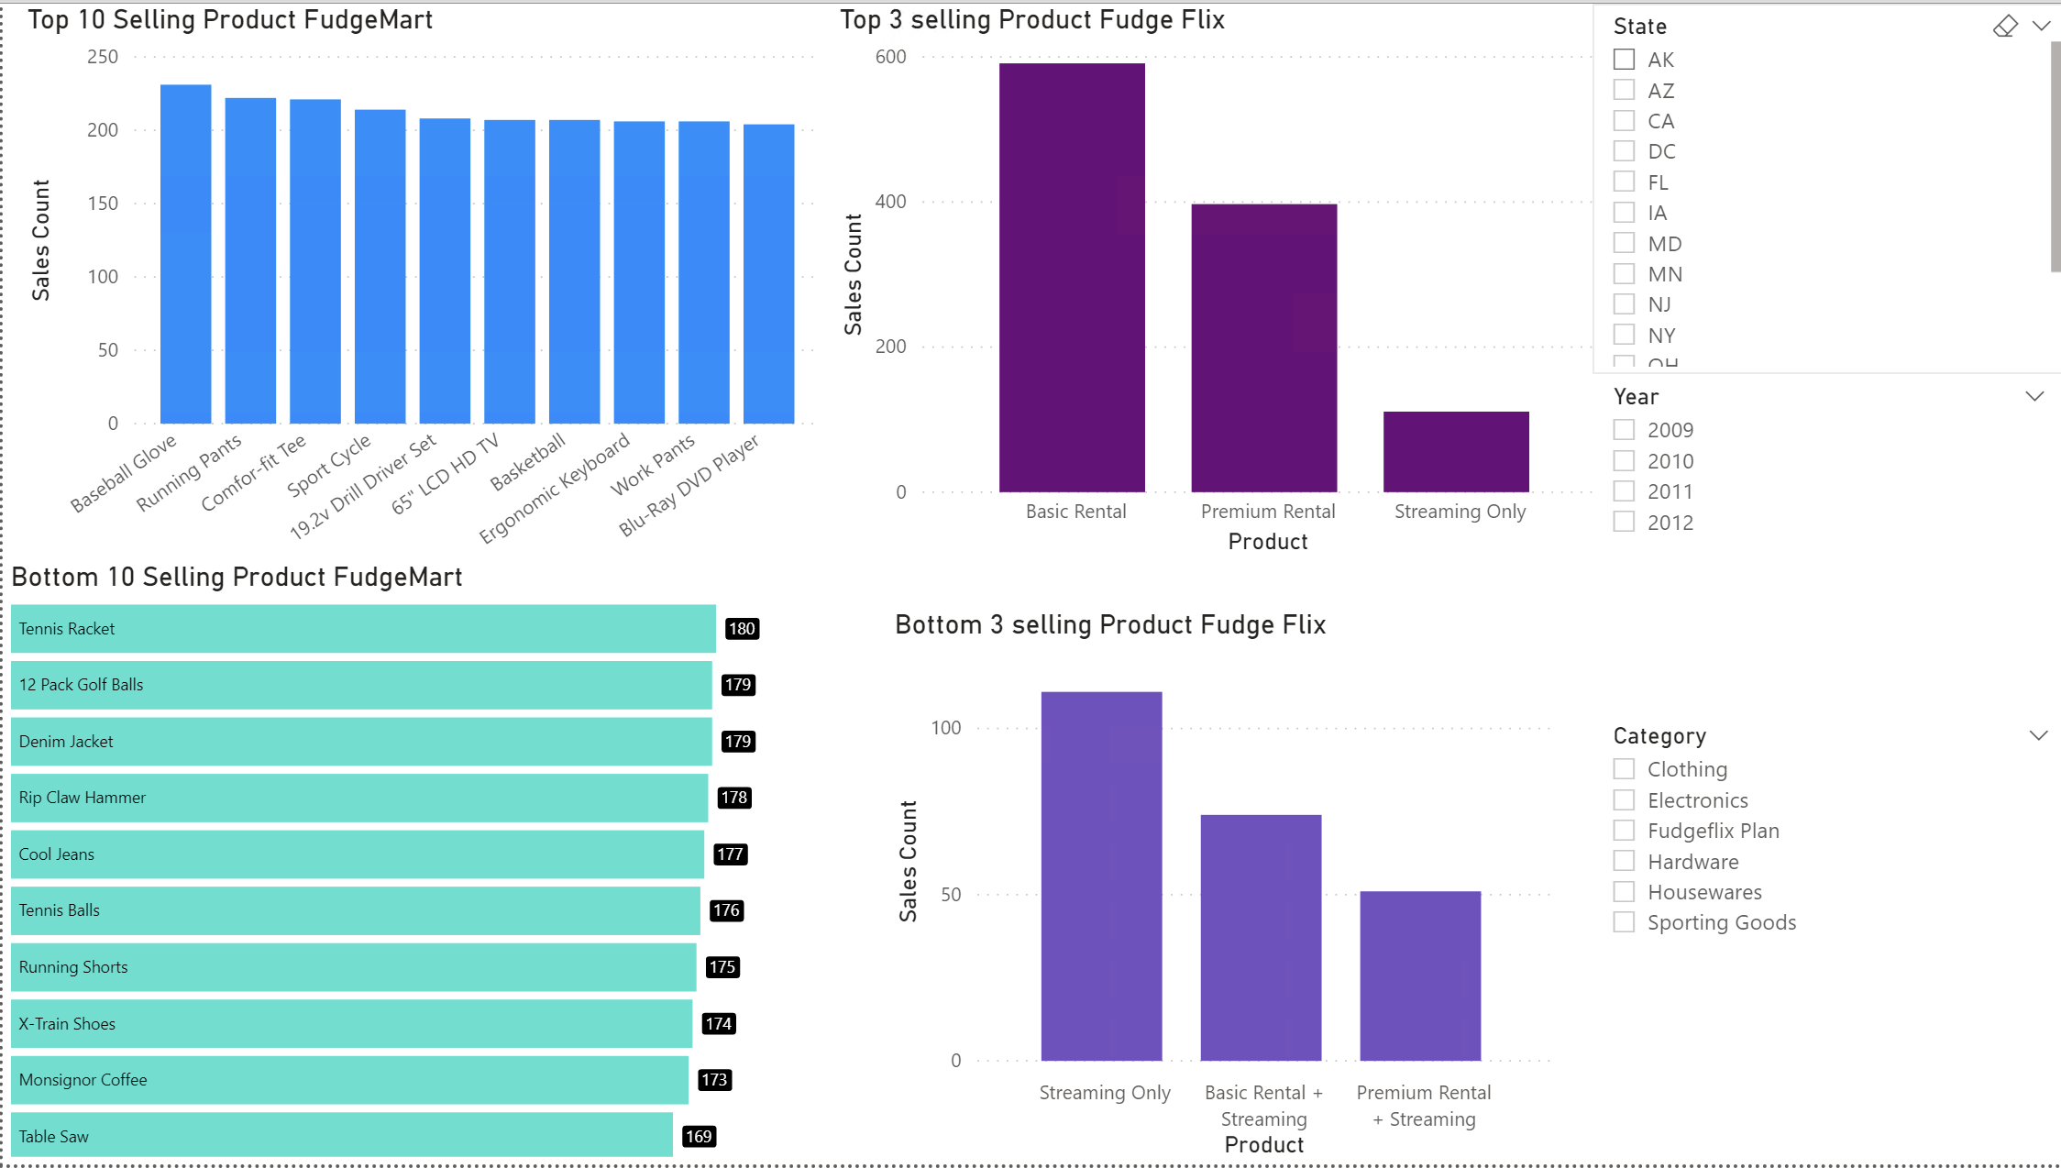
TOP-SELLING AND LEAST-SELLING PRODUCTS

Slide 13
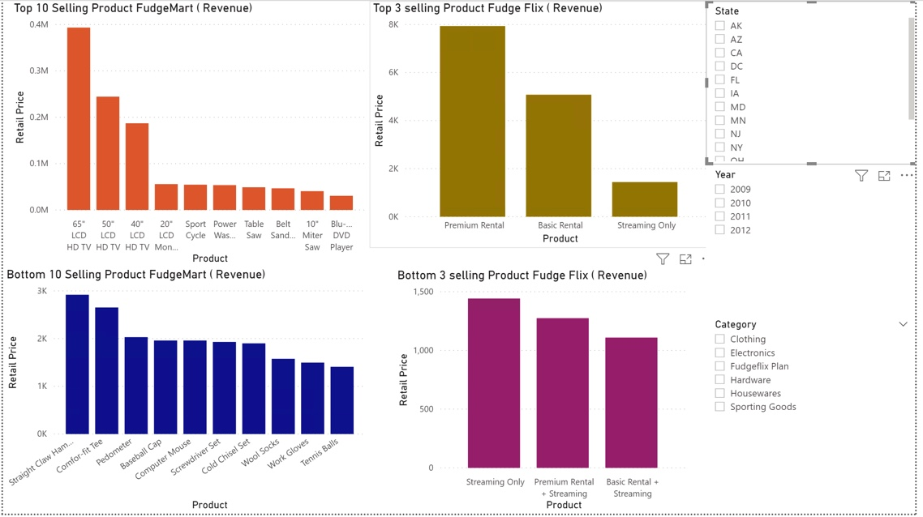
MOST REVENUE-GENERATING AND LEAST REVENUE- GENERATING PRODUCTS

Slide 14
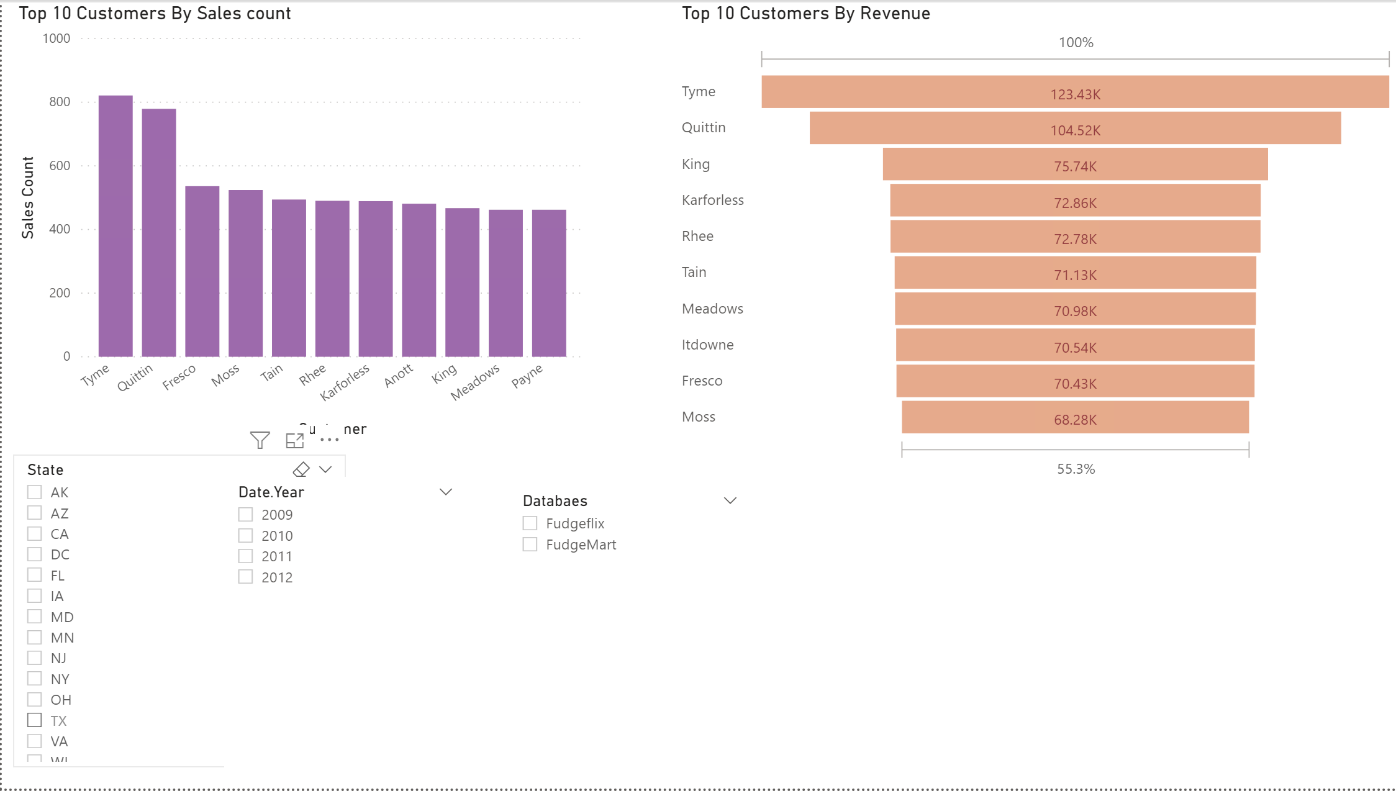
TOP LOYAL CUSTOMERS

Slide 15
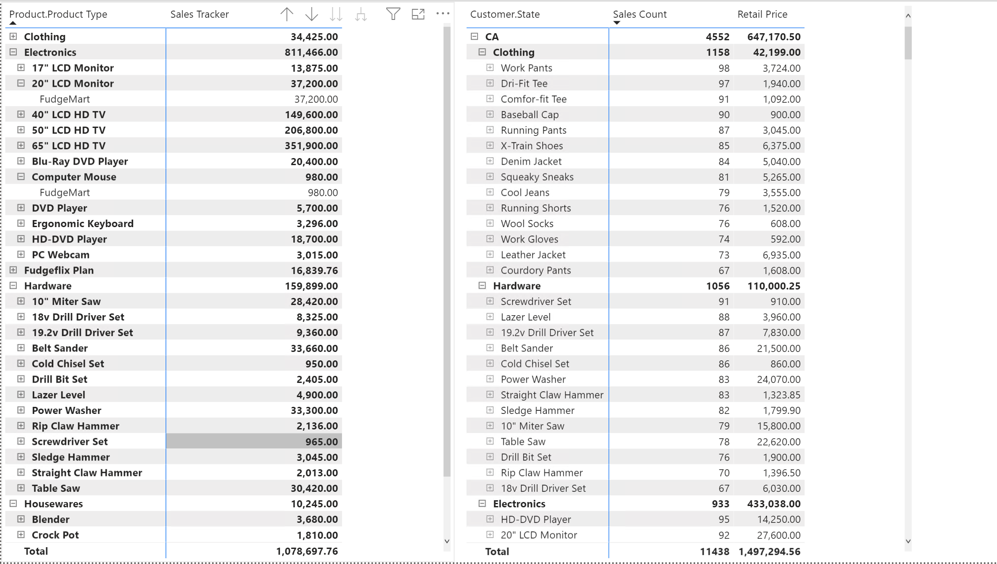
SALES TRACK

Slide 16
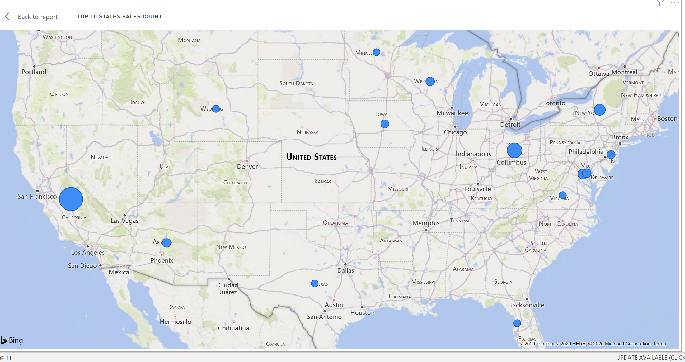
TOP STATES BY SALES COUNT

Slide 17
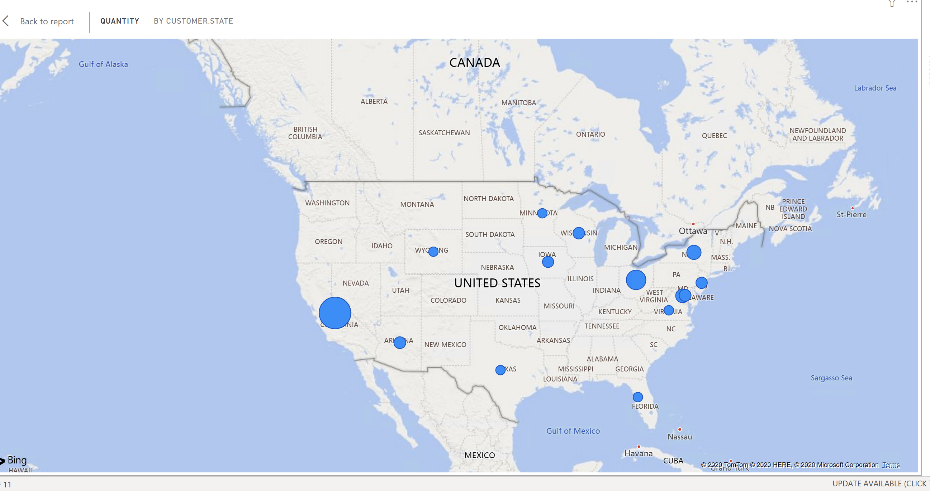
TOP STATES BY QUANTITY

Slide 18
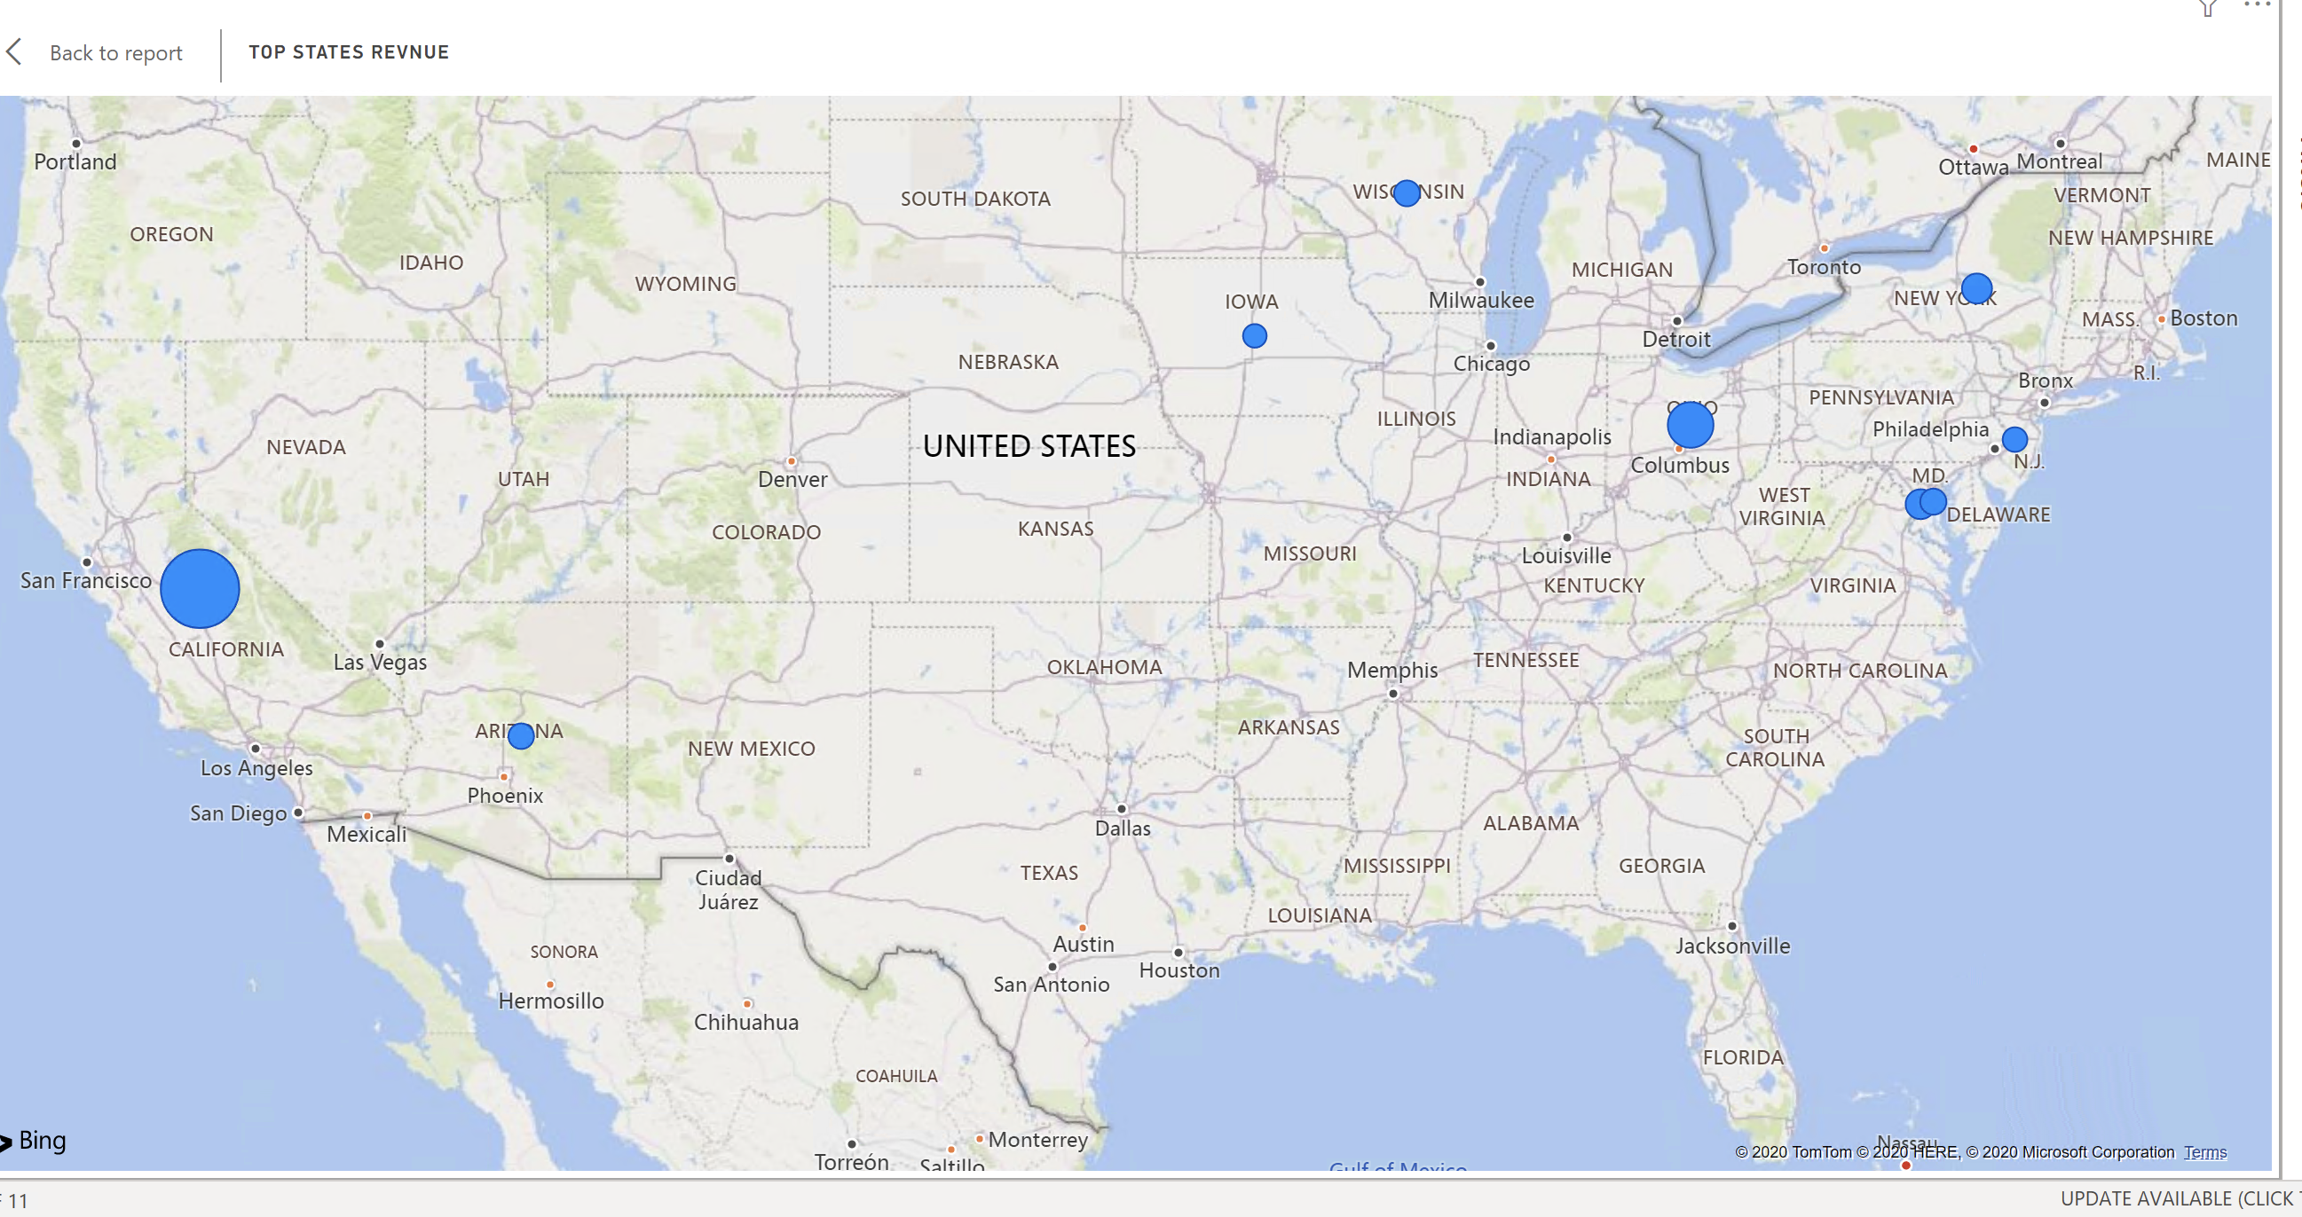
TOP STATES BY REVENUE

Slide 19
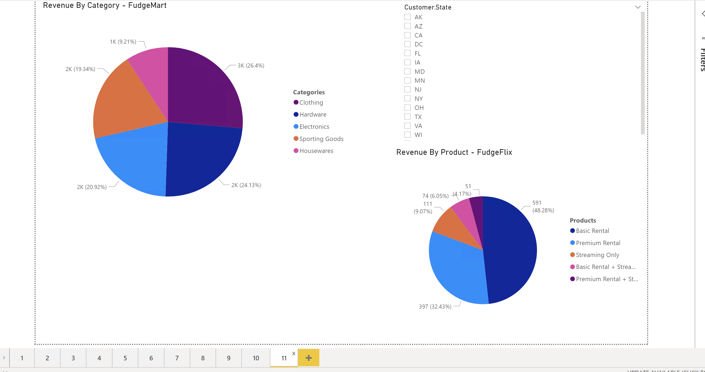
REVENUE BY CATEGORY

Slide 20
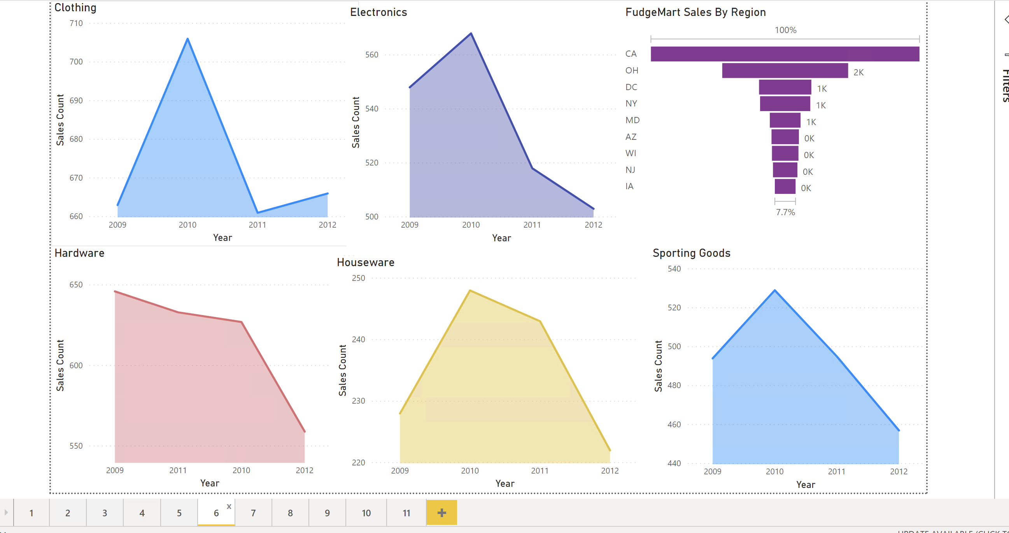
FUDGEMART: SALES COUNT BY CATEGORY AND REGION

Slide 21
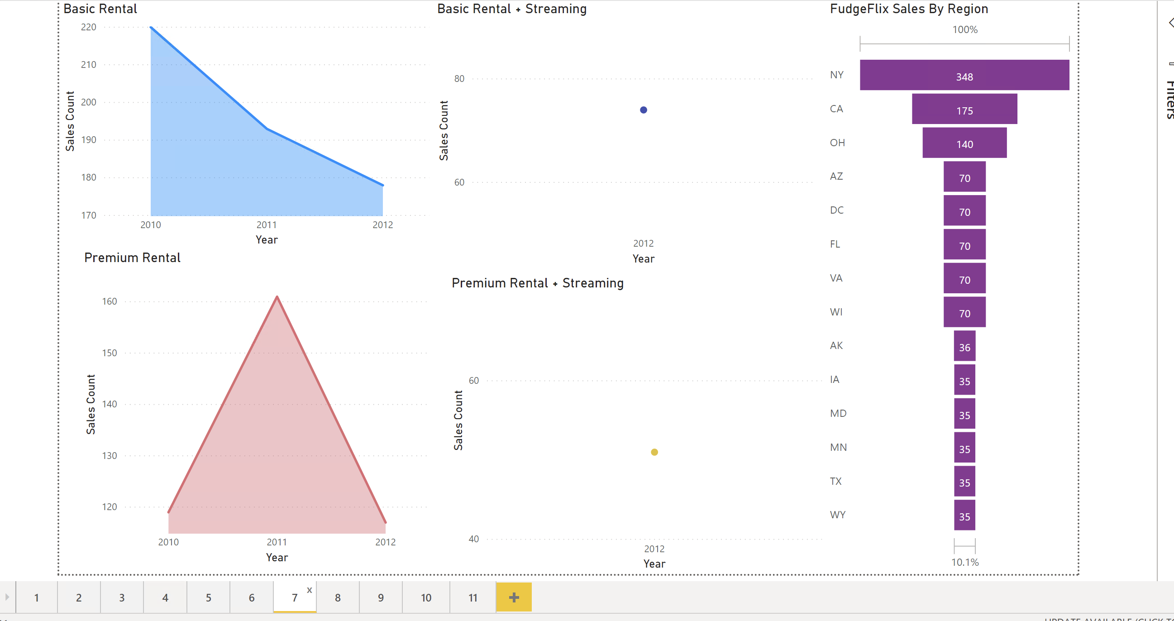
FUDGEFLIX:SALES COUNT BY CATEGORY AND REGION

Slide 22
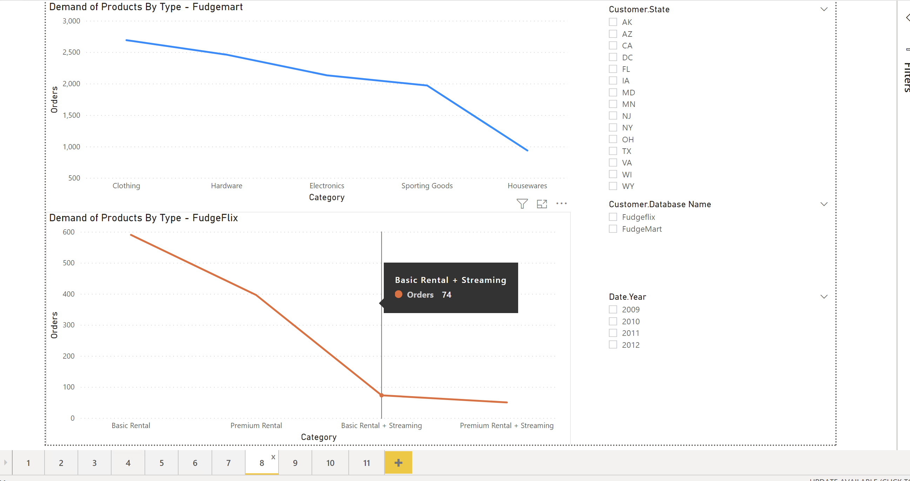
DEMAND BY PRODUCT TYPE

Slide 23
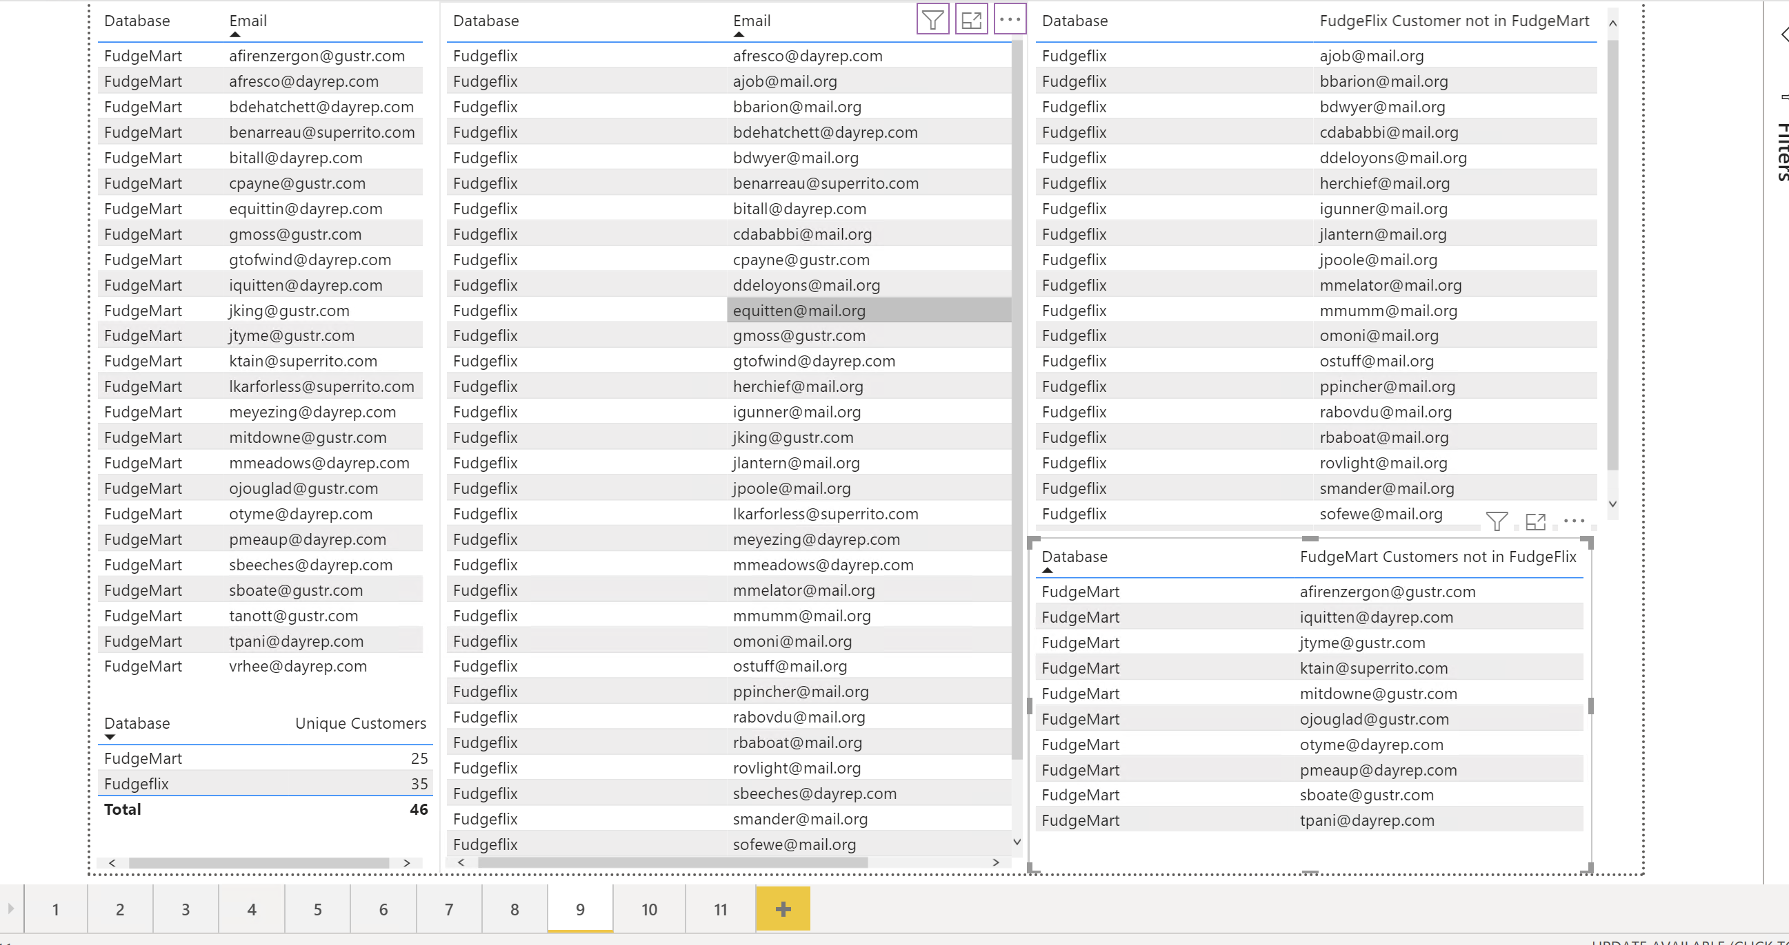
CROSS SELLING

Slide 24
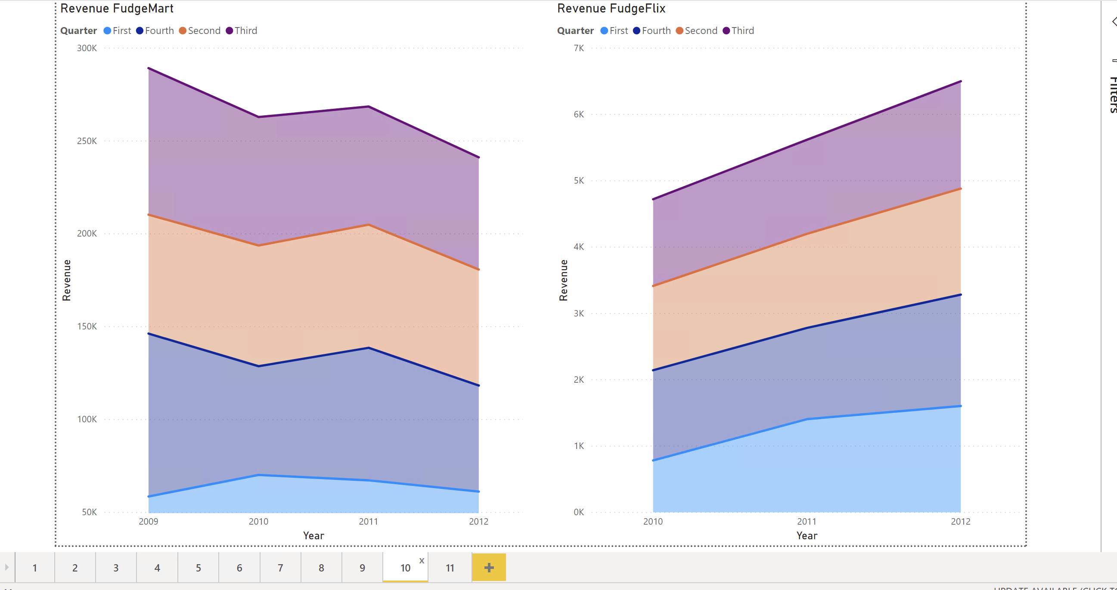
REVENUE BY YEAR AND QUARTER

Slide 25
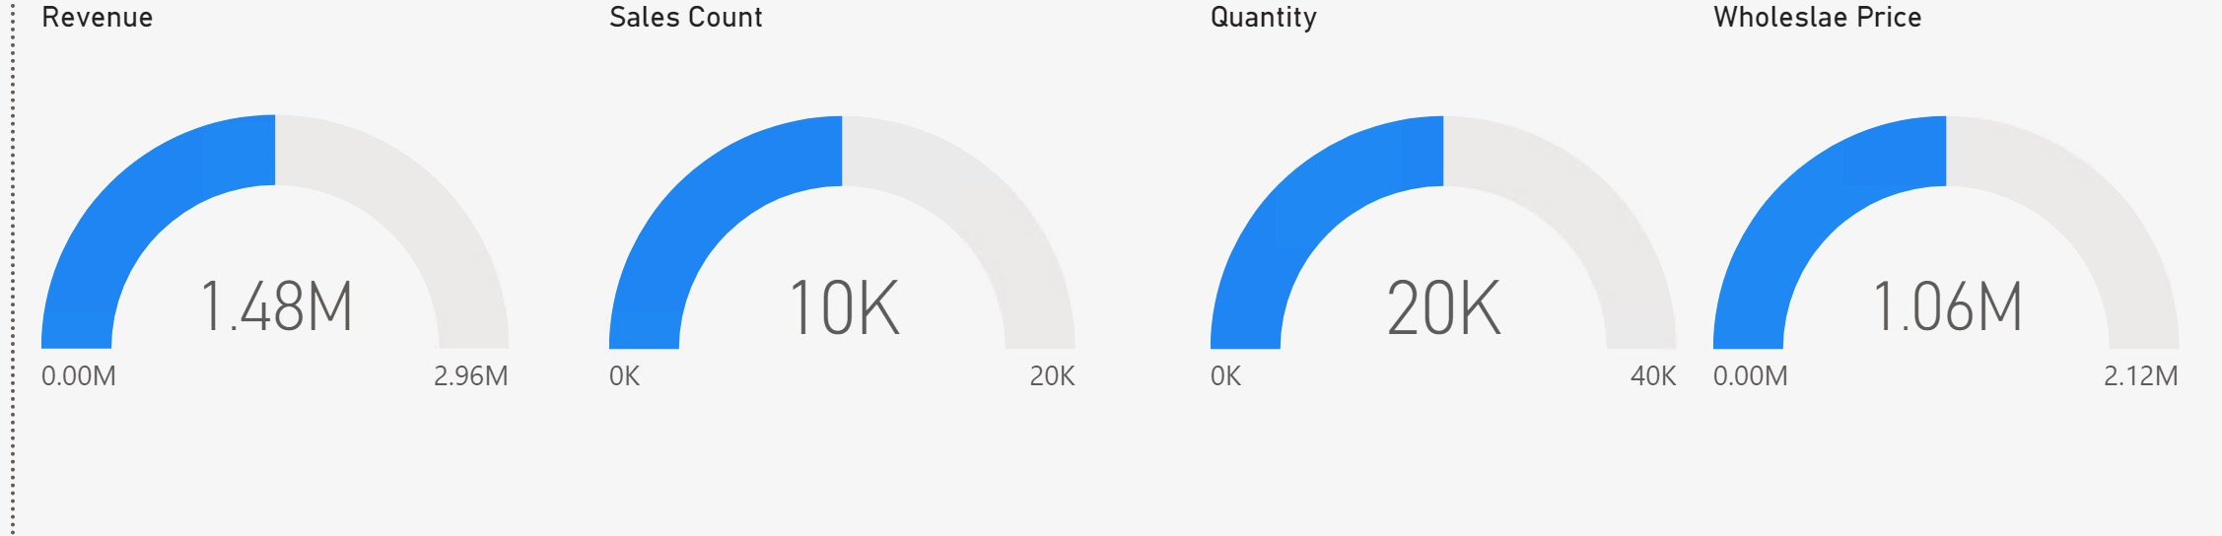

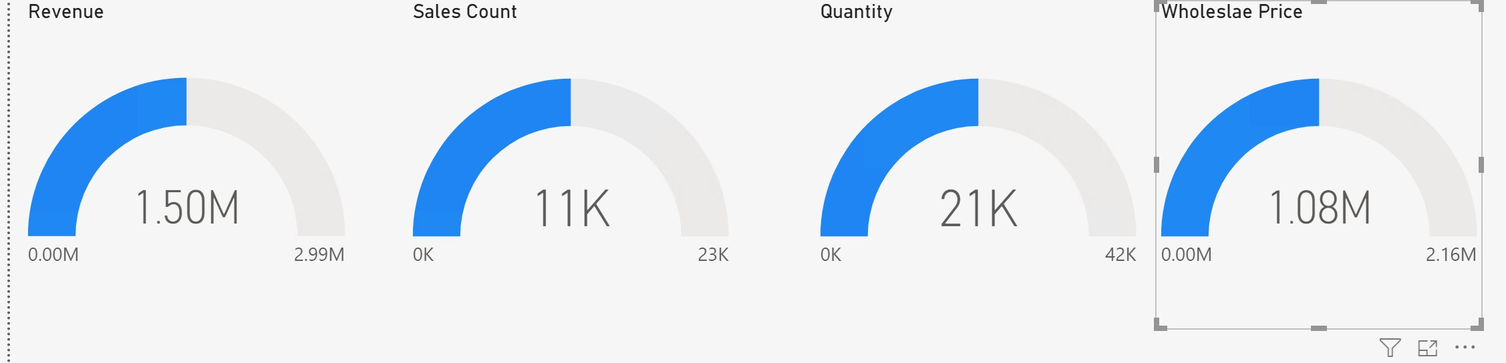
COMPARISON: REVENUE, SALES COUNT, QUANTITY, RETAIL PRICE
FUDGEMART
FUDGEFLIX
FUDGE CORPORATION

Slide 26
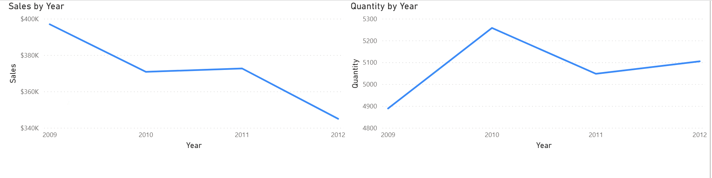
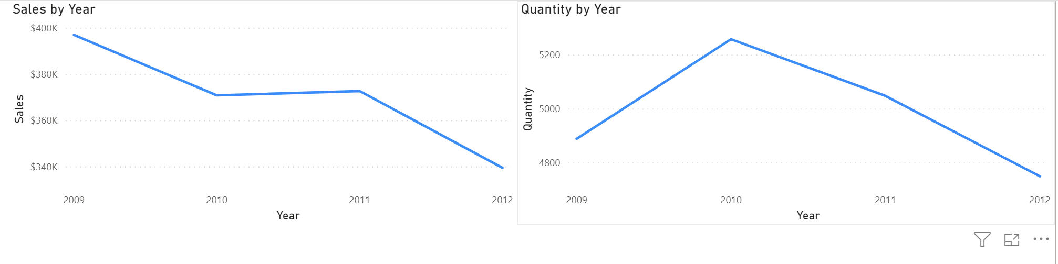
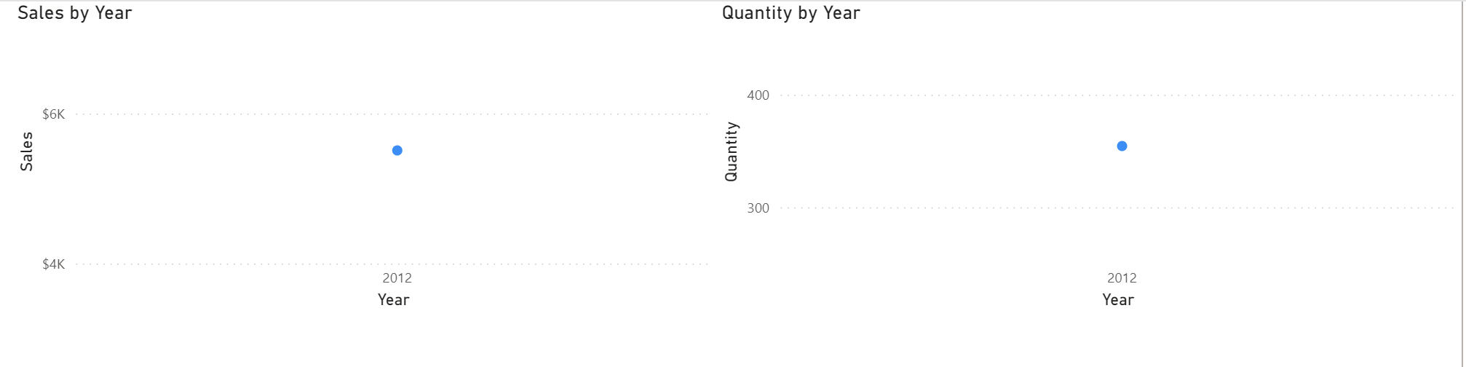
SALES AND QUANTITY BY YEAR
FUDGE CORPORATION
FUDGEMART
FUDGEFLIX

Slide 27
RECOMMENDATIONS BASED ON INSIGHTS
Use light discounting, volume discounting, better description of products, product recommendations to improve the sales of least selling product
For products generating less revenue but are sold in large scale, negotiate with the vendors
Use personalized experience and customer loyalty program to boost the customer lifetime value

Slide 28
RECOMMENDATIONS BASED ON INSIGHTS
Offer Fudgeflix plans to the Fudgemart customers to boost its sales
Use the feedback of best performing state’s customers to develop strategies to improve sales in poor performing states. For ex: Using California’s clothing customer data to improve clothing sales in Iowa
Ensure the inventory is stocked up in Fall season

Slide 29

THANK YOU!
Any questions?

